Slide 1
AWS Multi-Tenant Architecture: SaaS Application
By: Murtuza Saifee

Slide 2
Requirements
Designing a Scalable and Reliable Multi-Tenant Retail Platform
Scalability Across Multiple Tenants
High Availability
Real-Time Data Synchronization and Offline Support
Performance Optimization for High Traffic
Monitoring and Reliability Engineering

Slide 3
Design Approach
Cloud native approach in order to achieve the operational efficiency and maximizing business growth
3-tier cloud architecture patterns in order to provide the security and resilience to the system
Micro-services application architecture patterns for solid foundation and scalability.
Cell architecture along with Pool model for multi-tenant
Note: In this I am intentially not considering the Silo model for multi-tenant because I am considering that there are more than 10k customer, so it is not efficient to consider Silo in this case. Althought we can consider a mix of Silo and Pool but that will completely depend on the business requirments. As depending on the business tier, revenue model and customer’s requirement on the security and isolattion we can provide a Silo. That will be easy to manage from the above model (Cell + Pool) to have a Silo lets say for a platnium customer.

Slide 4
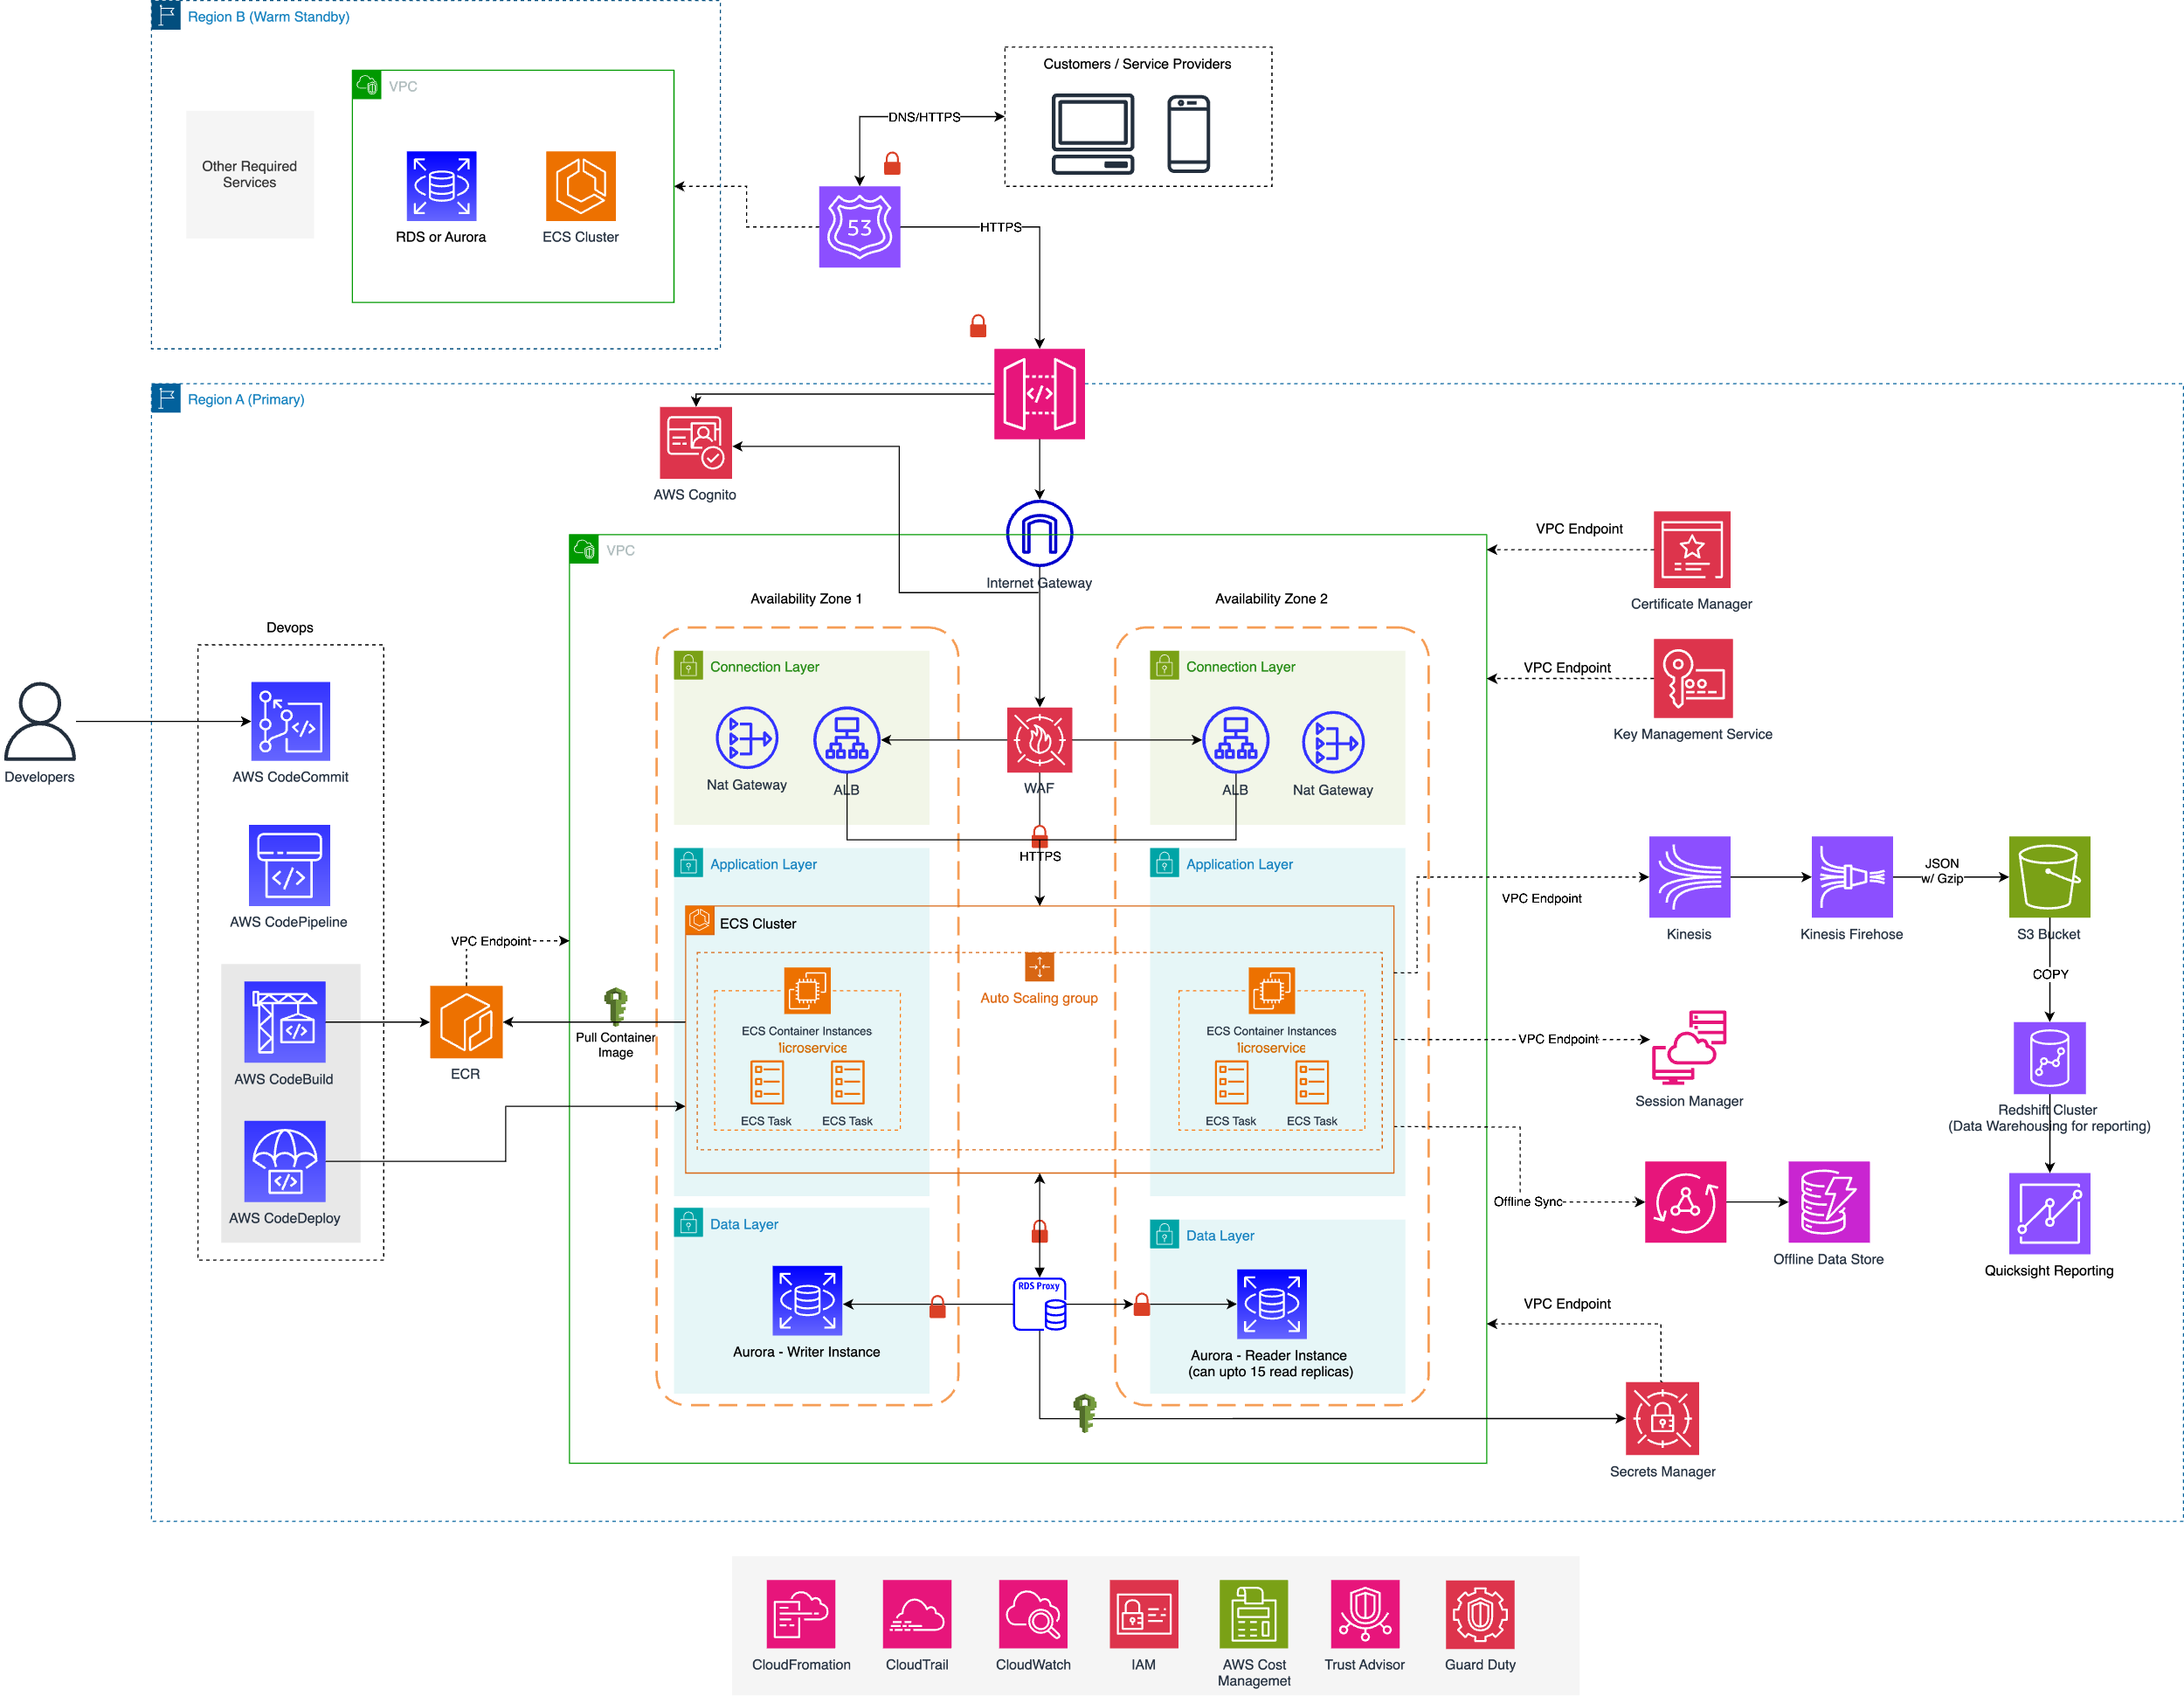
3-Tier Cloud Architecture

Slide 5
3-Tier Cloud Architecture - Layers
At its core, the 3-Tier Architecture divides an application into the following layers:
Connection Layer: Manages secure user access and traffic routing.
Application Layer: Hosts the application logic and processes.
Data Layer: Manages storage, retrieval, and data availability.
Each layer is isolated to enhance modularity, performance, and security, allowing independent scaling and management.
The Connection Layer forms the entry point into the system. This layer is responsible for user authentication, securing application traffic, and routing user requests. Along with that we can manage different tenant tiers and request limits based on their tiers through API Gateway.
The Application Layer is where the core business logic resides. It processes incoming requests and interacts with the data layer to respond to user actions. This application layer represented in above architecture will be micro-service architecture. Each micro-services can be designed with different compute and storage with the mix of Fargate, Lambda and EC2s if required.
The Data Layer is responsible for data persistence, ensuring that information is stored and retrieved efficiently and securely. On the data layer there will be different databases based on the requirements. Like Aurora and DynamoDb.

Slide 6
3-Tier Cloud Architecture – Reporting & Analytics
There will be a separate layer for the reporting and analytics. This layer will serve 2 purposes:
Analytics and Reporting
Data Recovery providing the low RTO and RPO (along with this we Cell-based architecture also provides high resilience, which will be detailed in later sections)
The way it will be achieved is through the combination of AWS Kiensis, S3, Redshift and Quicksight.
Data injestion will happen directly to the Kiensis. Sharding in Kinesis we can design on based on the tenant’s subscription teiring. This was we can combine our Cell and Pool model at the reporting data.
All the data can be then partioned in the Redshift Cluster based on the Unique Identifier of the Tenant.
One more layer of data isolation can be applied on the Reshift Cluster based on the Row-Level Security with the Unique Identifier of the Tenant. And the same Row-Level Security will carry forward till the QuickSight where each tenant’s and access their own data only.
All the data the flows through the Kinesis will be stored in S3 as all in form of Parquet file. This is data can be served for the recovery or reconcilation purpose in case if any system failure. Later this data can also be streamed to Databrick cluster (optional) for further processing. Data in S3 can also be Partioned based on the tenant with help of S3 prefix.
© 2024, Murtuza Saifee

Slide 7
Microservice Architecture
As explained previously we will be considering the Microservice architecture as a core of the platform. There are many reasons behind that but few of the top reasons of chosing microservices:
Service Independence
Data Isolation for Multi-Tenancy (This we will achieve with the combination of multiple things later in the study)
Elastic Scalability
Fault Isolation and Resilience
Unified Access and Authentication
Monitoring and Logging
Here we will be considering the mix of option in desiging microservice like some will be completely serverless and others will be container based. For example: for order microservice we can go fully serverless with Lambda and DynamoDb. This will help in achieving the multi-tenancy in terms of compute with Lambda and also in the storage with help of DynamoDB partion key. Three variation we can consider based on the business requiremtns:
Serverless microservice with Lambda and DynamoDB
Container based microservice with Fargate and Aurora
Container based miroservice with EC2 and Keyspaces (considering columnar based database for very high reads and writes)
Static content delivery via Cloudfront and S3. We can server the static contents like product catalogue images or static pages.

Slide 8


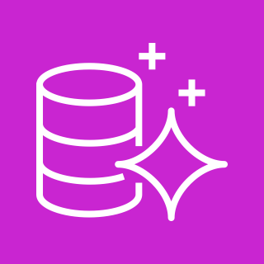




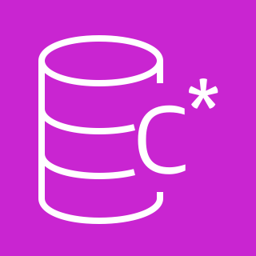



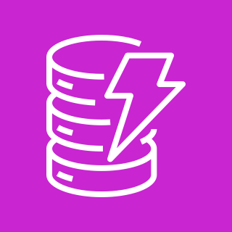
Microservice Architecture
Microservice A
Amazon Cognito
Amazon Aurora
Microservice B
Amazon CloudFront
Amazon API Gateway
Amazon Keyspaces
Microservice C
Amazon S3
Amazon Dynamo

Slide 9






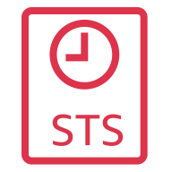

Multi-Tenant Isolation
Multi-tenant isolation can be implemented in a microservice architecture using Amazon Cognito, Amazon API Gateway, and AWS STS (Security Token Service) to manage and secure tenant-specific access, as shown below:
Amazon Cognito
User pool
Token Vending Machine
Authorized
OIDC
Authentication
flow
4
2
Validate token
Return tokens
Assume role
Identity
6
7
1
Login
API request
5
3
Application
Amazon API Gateway
Microservice
Bearer Token
STS Credentials
AWS Resources
8

Slide 10
Multi-Tenant Isolation
Login Request: A user initiates an API request by logging in to the application. This request is sent to authenticate the user and retrieve the necessary credentials.
Authentication: The login request is processed by Amazon Cognito, which manages user authentication for the multi-tenant environment. Amazon Cognito provides a User Pool where tenants’ users are managed, allowing identity management and access control for each tenant.
Bearer Token Issuance: Once authentication is successful, Amazon Cognito returns an OIDC (OpenID Connect) authentication token (Bearer token) to the application. This token represents the authenticated user’s identity and includes claims (metadata) about the user, such as tenant ID and user roles.
Token Validation: The application then forwards the bearer token along with the API request to Amazon API Gateway. API Gateway validates the token against the configured authentication provider (Amazon Cognito in this case) to verify that the user is authorized to make requests. This validation step ensures that only authenticated users with valid tokens can access the API.
Authorized Access: Once the token is validated, the API Gateway forwards the request to the appropriate microservice (that we discussed in earlier section). Based on the token’s claims (e.g., tenant ID), the microservice understands which tenant’s data is being requested and ensures that further actions are tenant-specific. Along with the Authorization we can also place the throttling based on the usage or different tiers. This way we can make sure to handle various problems like Noisy Neighbors, Over Usage of infrastructure by free tier/basic tier users.

Slide 11
Multi-Tenant Isolation
Role Assumption and Temporary Credentials: To access AWS resources securely, the microservice interacts with a Token Vending Machine (TVM) (details in the next section). The TVM, a custom-built service in the architecture, is responsible for issuing temporary, tenant-specific AWS credentials. It does this by:
Identifying the tenant context using the claims in the token.
Assuming an IAM role associated with the tenant’s permissions.
STS Credentials: AWS Security Token Service (STS) issues temporary credentials (e.g., IAM roles) that have specific permissions for the tenant’s resources. These temporary credentials ensure that the microservice can only access AWS resources within the scope of the tenant’s permissions, enabling resource isolation for each tenant.
API Response: After accessing the necessary AWS resources (e.g., S3, DynamoDB) with tenant-specific permissions, the microservice processes the request and returns the API response to the user. This response is sent back through API Gateway to the application, completing the transaction securely and in an isolated manner.
This architecture is well-suited as per the requirements that require secure, isolated access for multiple tenants, ensuring that each tenant's data remains private and protected within a shared infrastructure. As I mentioned earlier the design will be based on the Cell + Pool model, so that we can efficiently scale when the tenant grows within our shared infrastructure.
In the next section we will understand how we will be utilizing the Cell model for High Resilience and Reduce Outage Impact.

Slide 12



Cell-Based Architecture
Not to confuse with the earlier 3-tier architecture, as mentioned that will be at the core level and this will be at service level to serve different objectives.
Purpose of the cell-based architecture to achieve High Resilience and Reduce Outage impact. Instead of having a single monolithic setup as as single pool, the application is broken down into multiple cells, with each cell serving a specific segment of tenants. Consider it like deploying multiple production cells and have different number of tenants in each cell.
By using this let's say if production1 goes down then only 33% of tenants will get impacted rather than 100% of it if we deploy everything under a single unit. This is based on the initial consider of large number of tenants.
Also using this model, we can define the tenant allocation strategy based on the tiers.
All the tenants within each cell will use the shared pools of resources.
As mentioned in the earlier section, things like service throttling, API quotas and tier scoping can be handled at the API Gateway level.
Cell 1 (Platinum Tier)
Cell 2 (Advance Tier)
Cell 3 (Basic Tier)
ECS Cluster
ECS Cluster
ECS Cluster

Slide 13








Cell-Based Architecture
Routing Layer
Monitoring
5
1
2
Users
Application Load Balancer
AWS ECS
Cell router
DynamoDB
Cell assingment
AWS Cloudwatch
Cell 1
Cell 2
Cell N
Cell rebalancer
Deployment
3
6
AWS ECS
AWS ECS
8
AWS ECS
…
7
AWS Step Functions
AWS ECS
DynamoDB
DynamoDB
DynamoDB
4
AWS CodePipeline
AWS Cloudwatch
AWS Cloudwatch
AWS Cloudwatch
Central Analytics
7
AWS CloudFormation
Kinesis Data Streams
S3
Athena
© 2024, Murtuza Saifee

Slide 14
Cell-Based Architecture
Detailed steps as follows:
Clients connect to the routing layer. The routing layer redirects the client to the assigned cell using an HTTP redirect.
Routing information (user to cell mapping) is stored in DynamoDB. There is a fixed number of independent clusters that store copies of the data. For new users, the cell router pushes the new user information to all clusters.
The architecture is divided into a large number of independent cells of fixed size. The cells contain all application logic and storage.
Each cell has monitoring and alerting capabilities using AWS CloudWatch.
There is also a central dashboard which contains aggregated information (such as number of cells with and without errors).
Cell creation and update is automated using AWS Step Functions, AWS CodePipeline, AWS CodeDeploy, and AWS CloudFormation. Updates are first deployed to a canary cell. Disaster recovery for cells is fully automated.
Changes are streamed from all cells to a central data lake, where they can be queried using SQL in Athena.
A rebalancer can move users between cells, and also create new cells as needed. After a successful move, it updates the user-to-cell assignment. The old cell retains a marker to redirect clients to the new cell (not pictured in the diagram).
© 2024, Murtuza Saifee

Slide 15
Real-Time Data Synchronization and Offline Support
As per the requirements many tenants may operate in environments with unreliable internet connectivity, so in order to provide a reliable and robust solution we implement the offline model with the help of AWS Appsync and Local Data Store or Amplify (depending on the requirements).
During the offline mode POS can store data locally using local datastore by implementing local caching mechanism to hold un-synced data.
Use AWS AppSync for real-time GraphQL-based synchronization between devices and the cloud.
Using DynamoDB for storing tenant-specific data with a partition key (e.g., TenantID)
When devices reconnect, conflicts may arise if data has changed on both the local POS and in the cloud. We can handle this using:
Last write wins: The most recent data version overwrites the previous one.
Custom merge logic: The system merges updates based on specific fields.
AppSync supports built-in conflict resolution strategies (e.g., auto-merge, Lambda-based custom logic)
Online mode
Sync Data
Process data
Store data
Users
Application
AWS AppSync
AWS Lambda
DynamoDB
Offline mode
© 2024, Murtuza Saifee
Local Datastore

Slide 16
Real-Time Data Synchronization and Offline Support
We can implement certain decision criteria for the data source depending on the requirements. These decision criteria will help in achieving the robust and seamless user experience along with synchronizing critical data.
Decision Criteria for Data Source
Condition | Data Source | Why?
Device is offline | Local Database | Enables functionality without requiring connectivity.
Device is online | Cloud Backend | Provides the most up-to-date and authoritative data source.
High latency to cloud | Local + Cloud | Reads from the local cache; syncs writes to the cloud asynchronously.
By using the cloud as the authoritative source and the local database as a fallback, this hybrid approach ensures both offline reliability and real-time synchronization when online.
© 2024, Murtuza Saifee

Slide 17
Summary
Security, scalability and resiliance with the help of 3-tier and microservice architecture.
Multi-tenant isolation at different layer like compute isolation (with help of Cell + Pool model) and data isolation with help of partition key, row level security, sharding and bucket prefix.
Centralized reporting for the whole system through cloudwatch, config, guardduty and trusted advisor. Along with the individual cell metrics to manage tenants consumptions and reporting as well.
Easy tier management for tenants with help of Cell-based architecture.
Manage consumption and throtlling based on the tier via API Gateway.
Dynamic policy management at the user authentication and authorization level provide a tenants isolation and secure access management.
Serveless pattern to scale the compute with help of Lambda, Fargate, DynamoDB etc.
Offiline syncing mechanism with AWS AppSync.
Many other basic services like WAF, Network Firewalls, Cloudfront and Route53 for managing the requests and secruity at the edge.
Dynamic reporting through AWS QuickSight.
© 2024, Murtuza Saifee

